Slide 1

Preparing your organization for Grants
PREPARED BY NEAL WAUGH
BA, MSC, Ed.D. (Expected completion 2024).
Value Solutions Financial Services
www.vsfconsult.com

Slide 2

Maximizing Grants and Funding Opportunities
Implementation process:
Create a realistic annual budget
Design a diverse revenue strategy (Grants, donations, fundraisers)
Identify the areas that reflect the core competency of the organization

Slide 3
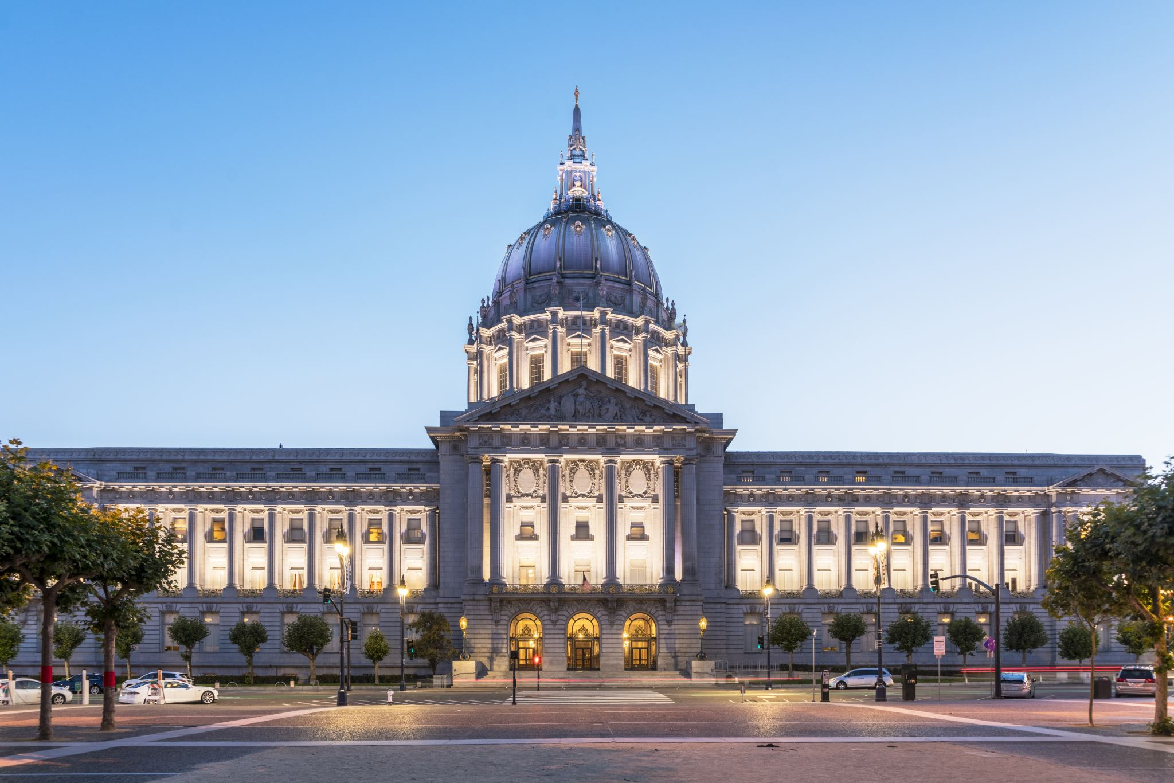
Registering with the Federal Government for Grants
Registering your non-profit with the Federal Government will afford access to a wide and substantial base of grant funds.

Slide 4
Search for grants that is in alignment with your organization’s profile
Write the grants for your organization
Strategize with your organization to achieve your revenue goals
Provide flexible professional fees to ensure affordability and profitability
Services we offer

